Slide 1
Private Equity Finance Section 1 to 5
Yang Xi’s study notes
Feb 2022

Slide 2
What does “Private Equity (PE)” mean to you?
An asset class for investment
Arguably include Venture Capital, Growth Equity, Buyouts, Distressed Debt, etc
Many specialist investment strategies further fragment the asset class.
Transactions, such as Buyout, leveraged buyout (LBO), etc
Venture Capital (VC) investment is usually not considered Private Equity. VC investments are structured very differently, as a unique investment type.
PE firms that organize and invest in buyout transactions
The entire industry of buyout firms

Slide 3
Private Equity Fund
A PE fund generally buys or invests in a company with the intention that it will improve its earnings or value, by providing capital and expertise, and then sell the investment at a profit.
“private” – non-public, unlisted
“equity” – shares, as distinct from property / financial instruments
Investors in a PE fund are mainly institutional investors.
Run by managers, on terms of investment management agreement and trust deed
The PE fund sells its investment in an exit transaction
Sale of company to a 3rd party buyer
Flotation of the company on a stock exchange (IPO)
With a share buy back, to use some or all money raised to buy back the shared held by PE fund
PE funds are usually set up with a lifespan of around 10 years
Initial set of investments ➔ several exits after 3-4 years ➔ another set of investments
Many Secondary Buyouts: one fund buys the shares (equity) from another fund

Slide 4
Private Equity Fund
PE funding is used by companies of all sizes
Start-ups (VC), expansion capital, management buy-outs (MBO), public-to-private deals
In MBO, PE fund teams up with existing senior managers of the target company, to form a new company which acquires the target company.
Leveraging - borrowed funds are used in acquisition
Ranking of funds
Senior Debt, usually provided by a bank
Junior Debt (mezzanine), may be provided by a different financier
Subordinated Debt – another way PE fund to make part of its investment
May be convertible into equity
PE investors

Slide 5
Benefits and Risks of Getting VC and PE Funding
Benefits
Access to capital
Sector expertise and experience
Network and connections
Appetite for risk: a portfolio view, medium-term time horizon
Disadvantages
Loss of control and management autonomy
Lengthy and complex investment process – about 6 months for a series
Uncertainty – there is no guarantee that an investment deal will close
Risk transference to management

Slide 6
Structure of a PE firm
The General Partner (GP) is the PE firm.
GP manages the fund, makes fund investments, aligns interests of the LPs
GP commitment to a fund: the PE firm’s own cash
Typically 1%, but expected to be a meaningful amount of their personal wealth
“skin in the game” - help to align the interests
Cash – cannot be waiver of fees / indirect investment
Fully liable, including negative returns
Limited Partners (LP) – external investors
External investors, including institutional investors and accredited investors.
Passive role – no inputs to the investment decisions
Committed Capital: money raise from LP
Liable for up to the full amount they invest
Operating Partners (OP)
Individuals with operating and industry experience, who help with deal sourcing and portfolio company management
Match LP to PE fund?

Slide 7
Structure of a PE firm
Good to know how long has a fund been setup
PE funds typically have a life-cycle of about 10 years
Investment Cycle (5 to 7 years) and Harvest (exit) Cycle (3 to 5 years)
PE funds typically aim to invest around 90% of the fund
Keep ~10% for further investment such as bolt-on acquisitions, further growth capital, etc
A fund will have a specific set of investment criteria
Different funds within a firm may have different goals and objectives
Sector / geography /investment stage / types of deal / investment size …
Firms rarely make cross fund investment
Conflicts of interest from different mix of LPs
Firms grow by raising new funds, as existing funds approach maturity and full investment (closed).
Funds typically charge 2% annual management fee on committed capital.
Usually 20% carried interest, and LPs share 80% of the return
Hurdle rate, usually 7% to 10%, much be achieved on-behalf of the LPs, before the GP can take some or all the performance related carried interest.

Slide 8
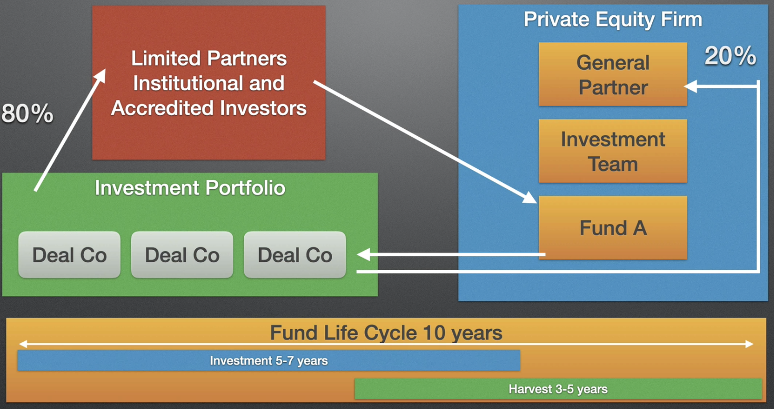
Structure of a PE firm

Slide 9
Limited Partnerships (LP) in PE
When the Fund is raised, GP and LPs sign a Limited Partnership Agreement
LP Clawback Clause: in case that the Fund does not have enough assets to meet liabilities, GP can claw back distributions already paid to the LPs to meet these liabilities
The LPA also outlines the duration of the Fund (~ 10 years). Funds are highly incentivized to exit within this cycle
Organization and Formation
Fund Raising ~ 2 years
Deal Sourcing and Investing ~ 3 years
Portfolio Management
Harvesting (exiting) ~ up to 7 years
Investment criteria: industry, stage, deal type, geography, etc
Limits the maximum investment per company
Key Person Clause: allows the investment to be paused if key person changed
Advisory Board: Consist of LP members, appointed by GP, to give advice, especially
Conflict of interest, Fund term extensions, amendments to the LPA
Do we have LPA data? Can we extract information from it?

Slide 10
Executive Roles in a PE Firm
PE firms tend to be much smaller than Investment Banks (IB). The organizational structure is usually flat.
Senior roles usually cover
Deal origination, Negotiation & Closing
Portfolio Management, Investment Decision Making
Fundraising
Compliance

Slide 11
Investors
Incubator: an organization provides start-up companies with space and resources
limited amount of cash (like 20 to 30 K)
Mentorship, network introductions, help with finding strategic partners and investors
Bootstrap: funding your startup from your own resources
Angel Investor
Typically high net worth individuals (HNI); not professional VC / PE
Use their own money, invest maybe $250 K to $500 K
Seek for large portion of equity (like 33%), often want to go on the board
Venture Capital
The first tranche of professional investors
Typically take a minority investment in high-growth early-stage companies
Usually companies post revenue, but pre-profit/positive cash flow
With negative cash flow – no access to debt – need VC investment
High risk, high return
“bad” financials can be seen as opportunity

Slide 12
Investor
Growth Equity
A PE firm makes minority/majority investment in an early-stage company
Aiming to transform less mature companies into market leaders
Usually target companies with proven product to be scaled
Mezzanine Finance – provided by specialist PE funds
Focus on junior/subordinated debt – ranked below senior debt, above PE funds
Yield 15% +, often with equity kicker warrants (convert to equity/indeed options)
Used to fill funding gaps, when senior debt is not being offered to the extent required by the lead PE investor
PE firms – range of firms focusing on various investment strategies
Investment size can be from millions to billions
Core center of the buyout market

Slide 13
Investors
Family Office - Investment firm established by a wealthy family
Manage assets and investments of the family
Long time horizon - not very focus on realization, but to build up asset portfolios
Strategic Investor
An established company invests in early-stage companies to gain access to new technology / business model
Often come in in-place-of a VC / a joint venture structure / option or intention to acquire the company
Give the founders the opportunity to grow the business before they bring it in-house
Corporate Venture Capital (CVC)
Established companies investing, either opportunistically or as part of a formal program, targeted at early-stage business often with innovative technology
Also a way to prevent competitors to take the technology
Crowdfunding (kickstarter, indiegogo)
An effective way since the last 5-10 years, for startup companies to raise small amounts from large number of non-professional investors, on very informal terms

Slide 14
Management Buyout (MBO)
A deal in which a business is bought from its owners by its management team, financed by a PE firm.
Common opportunities
Corporate restructuring – to buy the non-core business spun out
Sellout by the controlling shareholders / founders
Sale of the viable part of business, from a collapsed business, by a Receiver / Administrator
Parties in the deal – each has own agenda / priorities / interests / expectations
The seller
The Special Purpose Vehicle (SPV) company formed to make this acquisition
PE and 3rd party funders (usually banks)
Buyout Team – formed by different people within the party
Due Diligence Advisers (lawyers & accountants) – advise the buyers to check the quality and the correctness of the business they are buying
Financial Advisers
Tax Advisers
Legal
…

Slide 15
Management Buyout (MBO)
Funding
Debt / Equity / Working Capital Facilities (loans and overdrafts)
Banks normally provide debt funding
Amount varies from each deal – can be below 10% or above 70%
Banks usually seek to get security over assets – low risk
Earn interest payments and principle repayments
Private Equity (PE)
Maybe 40-50%
Alongside management, control relationship through Shareholder Agreement, which gives them rights and vetos
Management Equity
Usually the smallest amount, like 5-10%, but structured with highest potential capital gain
For the management to have a skin in the game
MBO provides the management with the opportunity to make a substantial capital gain for a relatively modest investment - driven by the management

Slide 16
Leveraged Buyout (LBO)
The core components of LBO are the same as MBO
The core difference:
While an MBO is driven by the management team, An LBO is driven by the PE firms and their financial goals.
The basic idea
Use debt to leverage (multiply) the power of your cash (your own equity)
When you sell, you have used the cash from the business to pay down the debt
This can greatly enhance the value of your original equity investment

Slide 17
More opinions to the MBO myths
The management does not need to contribute millions $ in MBO – the banks and PE firms will provide the bulk of the finance.
This is usually structured and organized by the corporate advisors, normally an IB
MBO can have an advantage over Trade Buyers, especially when the seller is the founder of the business, who trends to prefer the existing management
Investor prefer balanced team – experience, track record, leadership – not necessarily extraordinary
MBOs have been seen succeed in almost all sectors.
Average MBO size in UK is about 25m pounds - medium sized companies, divisions / subsidiaries of large companies
MBOs are not necessarily more risky than other deals.
How to define balanced team?

Slide 18
Buyout Terms
Leveraged Buyouts (LBO) – this terms applies to a variety of deal types
Most generic – LBO is a deal predominantly funded by debt (leverage)
Typically more mature and established business
Involve the controlling acquisition and majority acquisition by a PE / buyout firm
Corporate Carve Out
A company, often public, sells a non-core division/assets
Management Buyout (MBO)
Transaction led by the existing management to buy the parent company with the help of a PE firm
Management Buy-In (MBI)
Transaction led by an external management to come-in and buyout the business
High risk – new management will not have intimate knowledge of the business before the deal closes.

Slide 19
Buyout Terms
BIMBO – combination of MBO and MBI
External senior executive teams up with the existing management to buyout the company with funding from a PE firm
Middle Market Buyouts
Buyout market of the “middle market companies” – about $25m to $1bn revenue
Generic to deals around this size, not refer to any strategy
JAMBOG - Just Another Middle Market Buyout Group
Not very polite term, often used by Limited Partners (LP), referring to a middle market buyout firm failed to differentiate itself in the market

Slide 20
Buyout Terms – Secondary Transactions
Secondary Buyout
Company already funded by a PE firm, is sold to another PE firm
Not sold to a strategic / trade purchaser
Advantage – provide direct liquidity for the seller, without need of IPO / trade sale
There are specialist firms focusing on secondary transactions
Direct Secondary Transaction
The stockholder, in a private company funded by a PE firm, sells its stake to another individual / LP / PE firm
LP Secondary / Fund Secondary
An LP sells its LP interest in the Fund / company, to a 3rd party
Synthetic Secondary
An LP sells its economic interest (and liabilities) without transferring legal ownership
Secondary transactions can also take place when a 3rd party LP wants to buy into a PE fund. They can also occur purely for capital / cash flow / portfolio balancing reasons
Secondary Buyout – a previous buyout can bring attention

Slide 21
Investment Terms
Development Capital / Growth Capital / Expansion Capital / Growth Equity
Minority investments by PE firms to help companies scale
Other first institutional round of investment – Series A
Take Private / Public to Private
Acquisition of a public company by a PE firm
Bridge Finance / Bridge Loan
Usually used to fulfill short-term financing need
Money made available to a company by investor, until the next financing round
Normally structured as convertible debt, and convert into the investment round
Club Deal – two PE firms team up to invest in a company
Can be for financial reason, or complimentary expertise
Co-investment / Direct Investment
An LP invests directly into the company along side the PE firm, not through the fund

Slide 22
Investment Terms
PIPE – Private Investment in Public Equity
A predominantly been limited to the US market
Often an un-quoted instrument, created by the public company, for the PE firm, structured to delivery PE level investment return
Enable the public company to access PE funds in a uniquely structured transaction
Often used for a particular strategy / reason
Roll Up / Buy and Build
A PE investment strategy – the PE firm initially buys a “platform company”, and then makes a series of acquisitions of its competitors
Target to achieve market leadership / higher returns from economies of scale
Bolt On / Add On
Similar to Buy and Build, but more opportunistic – may be a one-off M&A transaction
Alternative Assets / Alternative Investments
A broad term for assets not cash / bonds / publicly quoted equity
Such as hedge funds, commodities, derivatives, etc.
Also include PE, VC, buyouts, mezzanine, etc.

Slide 23
Investment Terms
Money In
A development capital transaction, where money is put into the company by a PE firm
Money Out
PE firm acquires directly stock from a business owner, who takes the money out of the company (and puts into his own bank account)
Follow On Investment
An investor who has made an initial investment, invests in the next financing round
Often used to avoid being diluted in the deal
Often a right (option) specified in the terms of the original financing
Turnaround
A specialized investment in a financial distressed company, target to restore profitability
Initial cost is low, and the objective is clear – but can incur considerable cost because of financial and legal complexity

Slide 24
Investment Terms
Committed Capital
Total fund size – all commitments made by the LP
PE funds operate on a committed capital basis
Management fees are calculated on committed capital
Called Capital
Total amount actually paid-in by the LPs at a point in time
There is initial capital call, then over periods of time, further capital calls
Uncalled Capital = Committed Capital – Called Capital

Slide 25
Investment Terms
Users of PE firms data
Funds of Funds
PE funds which invest into other PE funds
Usually “Blind Pools” – when an LP invests in the Fund of Funds, it will not know which PE funds this Fund of Funds will take position in
Benefits to LP
Diversification
The investment team provides expert analysis of the targeted funds
Often have strategic / geographic specialization
Remove administrative burden – capital calls, capital distributions of all forms
Allow a small LP to gain access to wide range of PE funds
Good for new LP to get onboard PE asset class
Problems
Pay two sets of management fees
Diversification can lower the risk, but also lower the return
LP will have less access/relationship to the fund managers in the PE funds
May have longer and deeper J-Curve – negative returns at early stages before turning positive
LP will have less information of the companies getting invested
Less liquid (greater discount risk) compared to LP in PE funds, which has a secondary market

Slide 26
Categorize PE Firms
Types of firms
Leveraged Buyout Firms: KKR, Carlyle, TPG, Blackstone, etc
Normally take controlling stakes in business
Look for larger business with mature, ideally growing cash flow – they need the cash flow to fund the debt repayments
Typically financed with a mix of debt and equity
Growth Equity Firms: Summit Partners, JMI, TA Associates
Looking to scale up more mature business
Sort of bridging between VC and PE firm
Mix of equity & debt – usually limited debt – look for grow the business rather than financial
Venture Capital Firms: Kleiner Perkins, Sequoia, Accel, August Capital, etc
Tend to take minority stakes in a startup / early stage of business
A / B / C / D rounds - as the funding rounds happen, the mix of investors also changes
Look for talent, IP, technology

Slide 27
Categorize PE Firms
Scale: target company size, by revenue
large ($1 bn) / mid market (> $150m) / small
Sector Specialization – a particularly strong theme
There are a few generalists, but more and more firms are becoming specialists
Type of deals
LBO firms typically look for carve out deals
Acquire a non-core / subsidiary / division of a much larger busines
Expect to have strong cash flow to payout the financial leverage
Buy and Build Platforms
Growth Equity acquires a ”platform business” and then make acquisitions to scale it up
Public to Private Transactions
Delist a public company – usually take 100% of the equity – may give management an incentive with some equity – target to grow then exist by probably re-listing
MBO/MBI – founder exists

Slide 28
Categorize PE Firms
Specialist Funds
Specialist deals, distressed deals, turnaround/recapitalization deals, etc.
Real Estate
Mezzanine finance – a debt paying high coupon, subordinated behind the senior debt, able to convert into equity in certain circumstances, or it comes along with a warrant / coupon to give them an equity carry
Funds of funds
Secondary investors
buy deals from PE firms - usually do not originate their own deals
Often towards the end of the life of a fund, there are 1-2 business left, the fund needs to be wrapped up and exist, so the secondary fund will come in and buy those business
Pre-IPO funds
Company may need some finance before it gets to the IPO

Slide 29
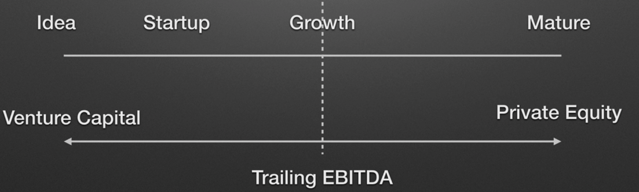
VC vs. PE
Essentially a question of deal stage
The dotted line is the point when the company starts to generate profit (EBITDA)
Earnings before interest, tax, depreciation and amortization
Short-hand for operation cash flow
When a firm has 12-24 months track record of historic EBITDA, it has matured into the PE space from the VC space

Slide 30
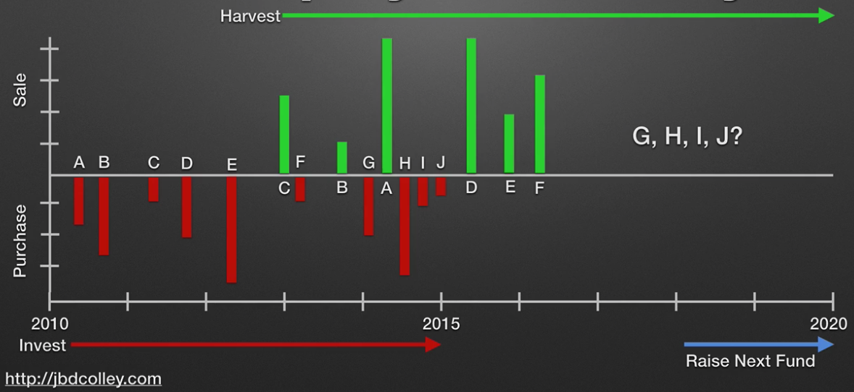
PE Firm Lifecycle
Each fund is a Special Purpose Vehicle (SPV)
A company with specific groups of investors, specific terms, be the investment vehicle for the company and its investment partners
Normally limited to a 10-year lifecycle
Raise funds for buyouts
Invest the money
Grow the business
Sell the companies and harvest the money
Towards the end, around 8 years, start to raise the next fund
Use the track record of previous funds to attract investors into the new fund
Illustration
Red – negative cash flow to make investment
Green – sell the investments and make a positive cash return
For example, company “C” was not successful, while company “B” was better
Company G, H, I, J – if cannot be sold, may look for a secondary fund to help exit

Slide 31
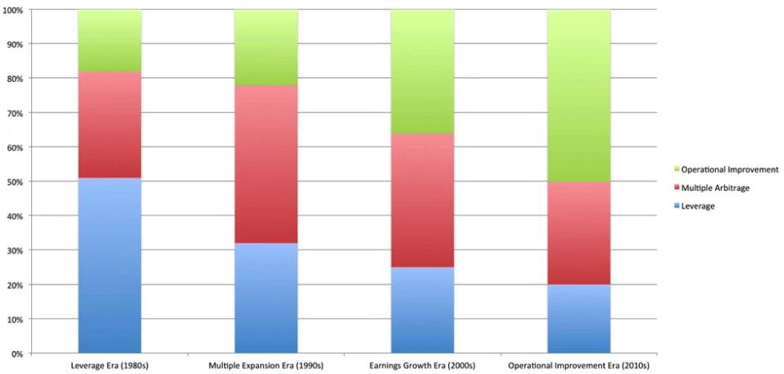
PE Value Creation
Three core principles
Operational Improvement
Improving the operation to make it more profitable – increase product range, land to new markets, increase prices, cut costs, make acquisitions, restructure, etc.
Multiple Arbitrage (Expansion)
Financial engineering - say, buy a company with 4-5x EBITDA, then sell with 6-8x EBITDA
Leverage
Use debt to part fund the deal, then use cash flow of the business to pay down the debt
Say, if you buy with 50/50 debt equity, and pay back all the debt, you have doubled the value
Evolving market
1980s: most value created through leverage, particularly using junk bonds
1990s: junk bonds got discredited – the game was arbitrage (buy-low-sell-high)
2000s: more focus on growing earning by simple means – cut cost, acquisition and divestiture (reduce the leverage in the business)
2010s: limited leverage from banks since 2008, smarter sellers and buyers, need much harder work to improve the business operation

Slide 32
PE Performance and Compensation
Say, there are 10 deals in a fund’s portfolio
Hope to have at least 2 blockbusters – low investment, big return
1 with triple money
2 with double money
3 with single money – get back their money
2 losses money – “bank took the keys”
Measure of returns
IRR (Internal Rate of Return)
Cash return – double / triple
Compensation
2% management fee
Deal fees, director fees
Carried Interest: 15% to 20% of profit on distributions, above a hurdle rate
We can use deal history to quantify risk of a PE

Slide 33
Find the Right Investor
Both VC and PE have their investment criteria – usually explained clearly on their website.
Industry Sector
Investment expertise in particular sectors, or even sub-sectors
There are exceptions – strategies which sector is less specific, such as pre-IPO investors
Stage of Company
Some only invest in early stage / Series A. Some only do companies with cash positive.
Some only do secondary buyout, etc.
Geography: where the investor have got a local office
The smaller deal / earlier stage, the closer relationship in geographical terms need to be.
In general, demand from entrepreneurs exceeds the supply from investors.
An investment firm may look at 500 deals in a year, 100 in detail/with meetings, and finally invest in 5 (rarely more than 10)
Investment firms are swamped with unsolicited calls from entrepreneurs – mostly ignored – better to develop the relationship before you need the money!
Or get introduced by a trusted colleague / entrepreneur / lawyer / accountants

Slide 34
Find the Right Investor
Important! Make sure the investors have NOT already invested in your direct competitor
If you meet such investors, they will be happy to learn your plans and secrets, to their advantage
But they won’t invest in you, because of conflicts of interest
Well-prepare your elevator pitch and investor deck
Not a sprint – but a marathon – usually at least 6 month – no guarantee
Initial meeting can take several weeks
Many conversations / presentations to their investment partners
Issuance and negotiation of a term sheet
Continuously doing due diligence – transaction documentations
Make sure you are right for each other
This is a relationship for about 5 years
If things go wrong after the deal, likely you will leave the business

Slide 35
Is PE the Right Option for You?
You have a number of options to get funding
Bootstrap, bank lender, angel investor, VC, growth equity, PE, family office, IPO …
Critical questions
Are you happy to sell more than 50% of your business?
Yes – PE or family office
Are you seeking an active investor who will take a close interest in your business and help you?
Yes – VC, Growth Equity, PE
Are you looking for a long-term investor?
Yes – Angel investor (3-5), PE (3-5), Family Office (can be very long), IPO
Angel investor and PE may also have short-term interest under some circumstances
Are you an early-stage company, such as pre-revenue, pre-profit, pre-positive-cash-flow?
Yes – Angel investor, VC, growth equity
Make sure your source of funds has
Access to funds – they don’t have to go to somebody else to raise money
They have the authority (right level of person in the firm) – not associate but partner

Slide 36
PE Checklist for Entrepreneurs
Do they invest in companies at your stage of development
Idea initiation / start up (developing first product) / prototype (proof of product) / 1st customer (proof of customer demand) / sales growth / cash positive / market share growth / scale
Stage of investment
Seed / Angel / Series A / Series B, C, etc / Pre IPO
Secondary / turnaround / MBO / MBI
Types of investment in later stage deals
Special situations / distressed / development capital / mezzanine / venture debt / junior equity
Sector (and sub-sector)
No competing companies in their portfolio
Geographic limitations
Where are their offices – proximity is important for on-going relationship

